Slide 1
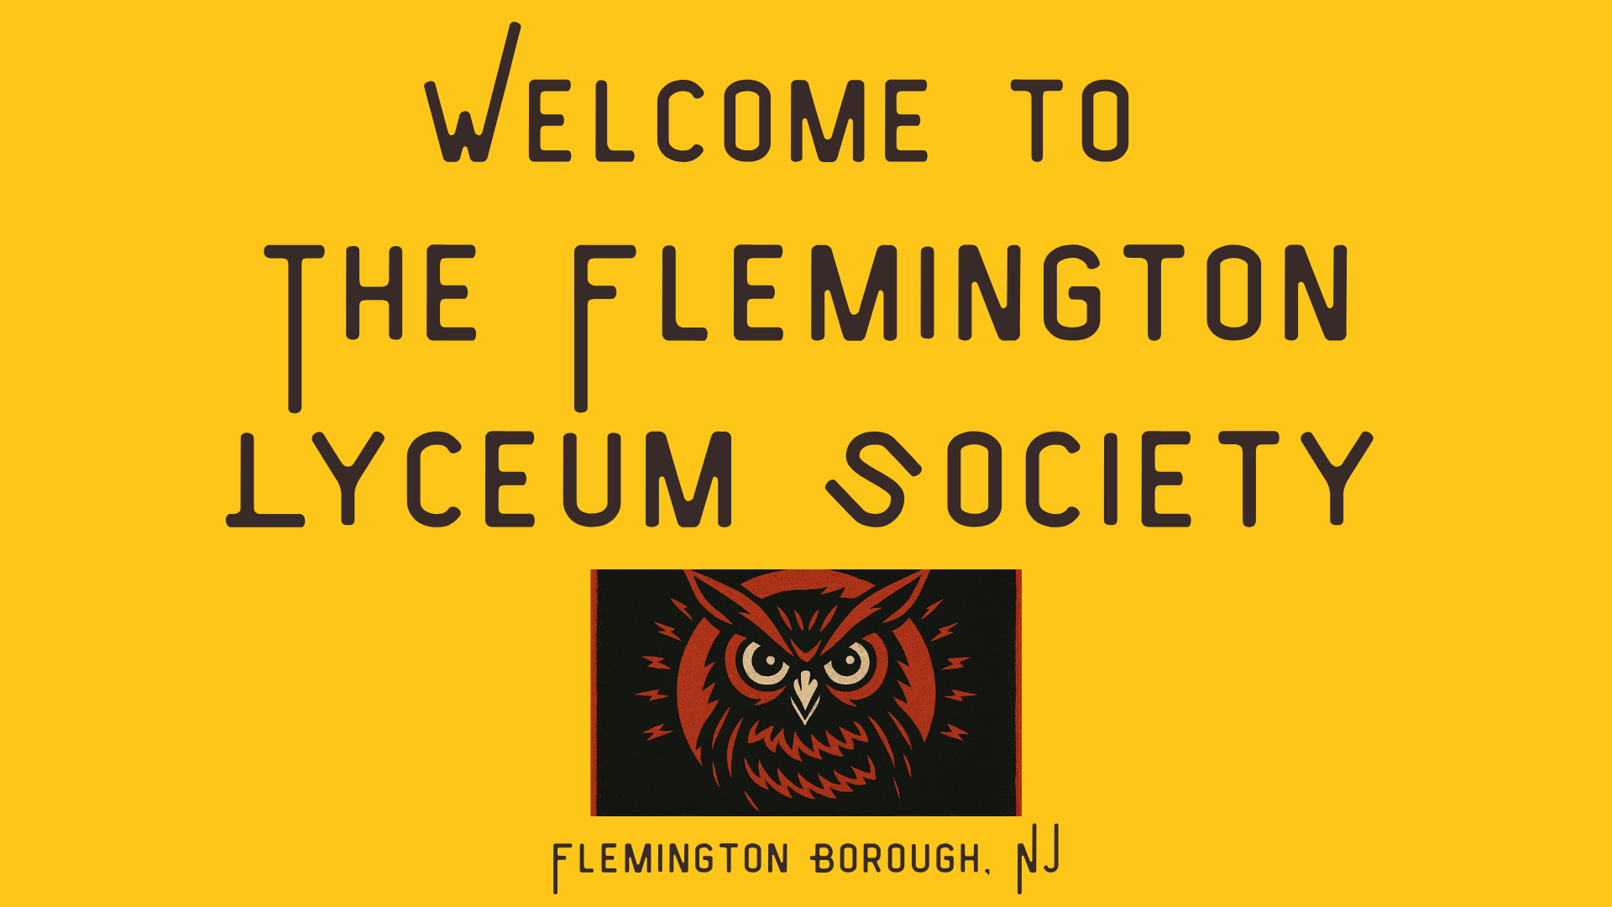

Slide 2
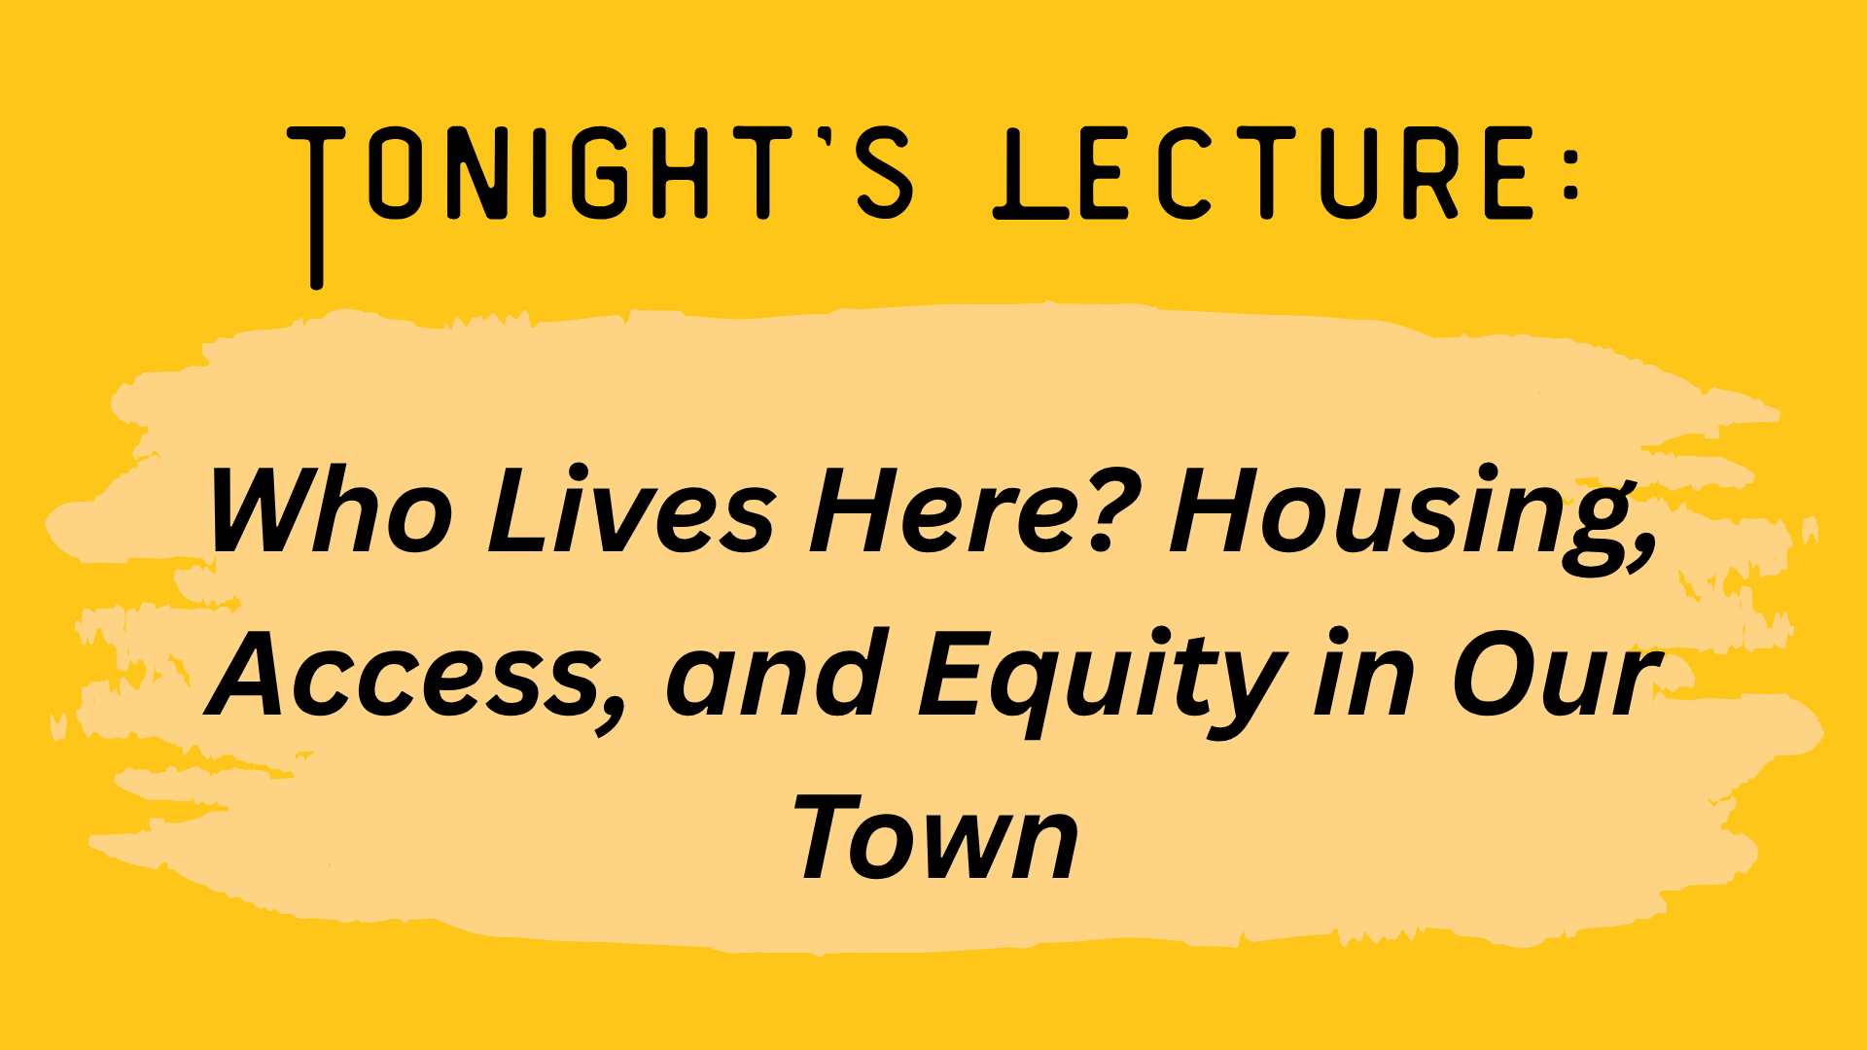

Slide 3
when was Flemington great?

Slide 4
Early Data – Hunterdon County
First Census (1790)
  20,153 People in all of Hunterdon County
    Of the 1492 people listed as non-white, 1301 were enslaved
First designated a “town” in 1870
  36,963 in the county
    49.5% male
    634 listed as “colored” – none as “Chinese” or “Indian”
    1897 are “Foreign-born”

Slide 6
Early Data – Hunterdon County
First Census (1790)
  20,153 People in all of Hunterdon County
    Of the 1492 people listed as non-white, 1301 were enslaved
First designated a “town” in 1870
  36,963 in the county
    49.5% male
    634 listed as “colored” – none as “Chinese” or “Indian”
    1897 are “Foreign-born”
  Flemington estimate is 1,412
1910 – Flemington Borough created

Slide 7
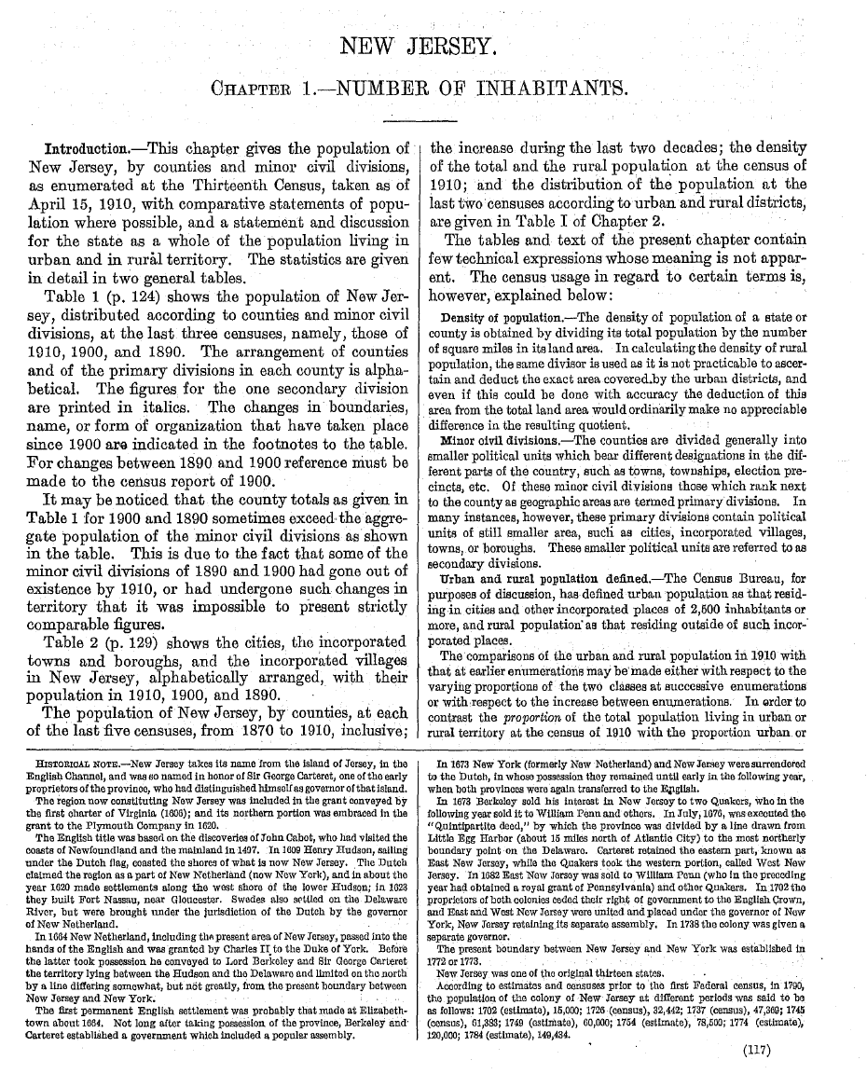

Slide 8
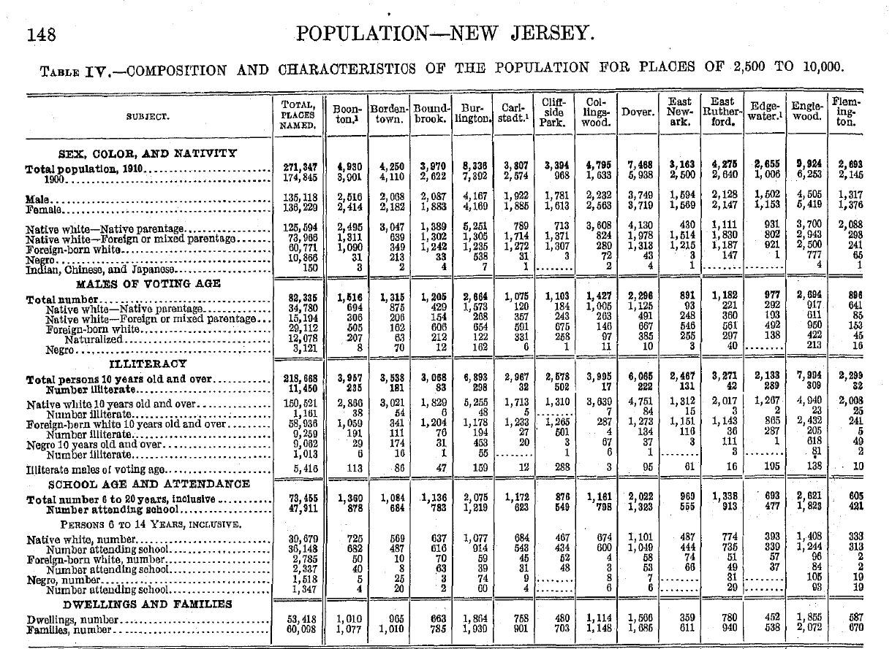
Flemington Borough (1910)
From the 1910 Decennial Census Report | 1890 | 1900 | 1910
Raritan Township, including Flemington village | 3,798 | 4,037 | 4,003
Flemington village | 1,977 | 2,145 | 2,693

Slide 9
Flemington Borough (1910)
SEX, COLOR, AND NATIVITY | Flemington
Total poulation 1910 | 2,693
1900 | 2,145
Male | 1,317
Female | 1,376
Native white - Native parentage | 2,088
Native white - Foreign or mixed parentage | 298
Foreign-born white | 241
Negro | 65
Indian, Chinese, and Japanese | 1

Slide 10
Flemington Borough (1910)
MALES OF VOTING AGE | Flemington
Total number | 896
Native white - Native parentage | 641
Native white - Foreign or mixed parentage | 85
Foreign-born white | 153
Naturalized | 45
Negro | 16

Slide 11
Flemington Borough (1910)
ILLITERACY | Flemington
Total persons 10 years old and over | 2299
Number illiterate | 32
Native white 10 years old and over | 2008
Number illiterate | 25
Foreign-born white 10 years old and over | 241
Number illiterate | 5
Negro 10 years old an over | 49
Number illiterate | 2
Illiteratre males of voting age | 10

Slide 12
Flemington Borough (1910)
SCHOOL AGE AND ATTENDANCE | Flemington
Total number 6 to 20 years, inclusive | 605
Number attending school | 421
PERSONS 6 TO 14 YEARS, INCLUSIVE
Native white, number | 333
Number attending school | 313
Foreign-born white, number | 2
Number attending school | 2
Negro, number | 19
Number attending school | 19
DWELLING AND FAMILIES | Flemington
Dwellings, number | 587
Families, number | 670

Slide 13
Growth of Flemington & hunterdon, 1940-2000

Slide 18
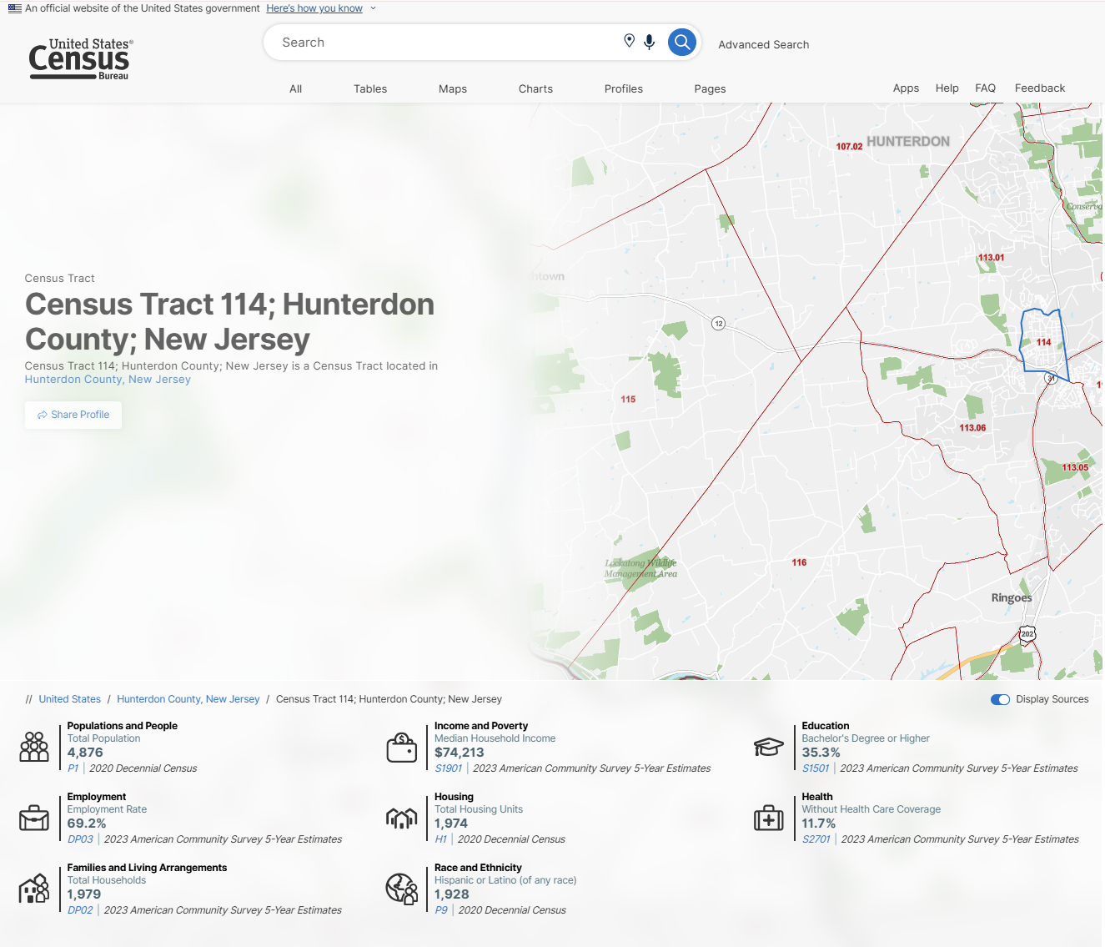

Flemington Today
Go to data.census.gov and search

Slide 19
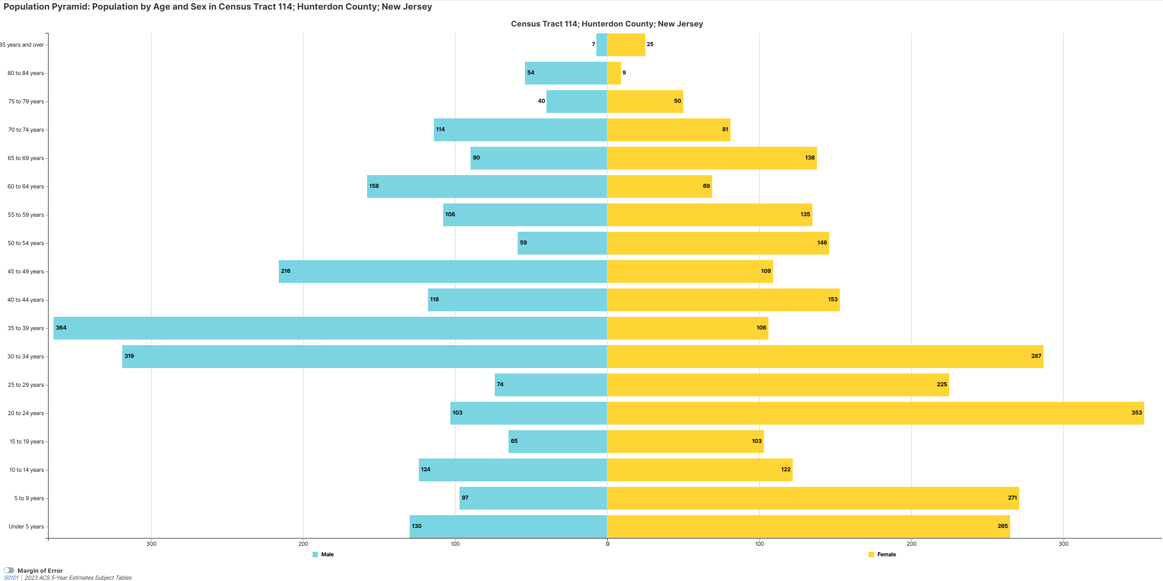

Slide 20
Who we are…
Language Spoken at Home
  42.6% (± 7.6%) Language Other Than English Spoken at Home, Flemington Borough
  13.4% (± 2.1%)Language Other Than English Spoken at Home in Hunterdon County, New Jersey
Native and Foreign-Born
  33.3% (± 7.0%) Foreign-Born population, Flemington Borough
  11.6% (± 1.6%) Foreign-Born population in Hunterdon County, New Jersey
Older Population
  12.4% (± 2.8%) 65 Years and Older, Flemington Borough
  21.2% (± 0.5%) 65 Years and Older in Hunterdon County, New Jersey

Slide 21
Who we are…
Income and Earnings
  $74,213 Median Household Income, Flemington Borough
  $137,275 Median Household Income in Hunterdon County, New Jersey
Poverty
  11.9% Poverty, Flemington Borough
  4.9% Poverty, Hunterdon County, New Jersey
Educational Attainment
  35.3% (± 8.5%) Bachelor's Degree or Higher, Flemington Borough
  58.7% (± 2.6%) Bachelor's Degree or Higher in Hunterdon County, New Jersey

Slide 22
Who we are…
 | Estimate
Total: | 4,876
Hispanic or Latino | 1,928
Not Hispanic or Latino: | 2,948
Population of one race: | 2,839
White alone | 2,350
Black or African American alone | 133
American Indian and Alaska Native alone | 7
Asian alone | 317
Native Hawaiian and Other Pacific Islander alone | 1
Some Other Race alone | 31

Slide 23
Who we are…

Slide 24
Housing in Flemington Borough
 | Estimate | Margin of error | Percent
Total housing units | 2,058 | ±183
Occupied housing units | 1,979 | ±171 | 96.2%
Vacant housing units | 79 | ±72 | 3.8%
Homeowner vacancy rate | 0.0 | ±5.9
Rental vacancy rate | 0.0 | ±3.2
 | Estimate | Margin of error | Percent
UNITS IN STRUCTURE
Total housing units | 2,058 | ±183 | 2,058
1-unit, detached | 681 | ±138 | 33.1%
1-unit, attached | 152 | ±97 | 7.4%
2 units | 202 | ±108 | 9.8%
3 or 4 units | 334 | ±150 | 16.2%
5 to 9 units | 97 | ±61 | 4.7%
10 to 19 units | 305 | ±144 | 14.8%
20 or more units | 287 | ±147 | 13.9%
Mobile home | 0 | ±14 | 0.0%
Boat, RV, van, etc. | 0 | ±14 | 0.0%

Slide 25
Housing in Flemington Borough
 | Estimate | Margin of error | Percent
YEAR STRUCTURE BUILT
Total housing units | 2,058 | ±183 | 2,058
Built 2020 or later | 9 | ±16 | 0.4%
Built 2010 to 2019 | 24 | ±23 | 1.2%
Built 2000 to 2009 | 144 | ±104 | 7.0%
Built 1990 to 1999 | 114 | ±79 | 5.5%
Built 1980 to 1989 | 110 | ±63 | 5.3%
Built 1970 to 1979 | 498 | ±211 | 24.2%
Built 1960 to 1969 | 49 | ±41 | 2.4%
Built 1950 to 1959 | 386 | ±146 | 18.8%
Built 1940 to 1949 | 209 | ±101 | 10.2%
Built 1939 or earlier | 515 | ±135 | 25.0%

Slide 26
Housing in Flemington Borough
 | Estimate | Margin of error | Percent
BEDROOMS
Total housing units | 2,058 | ±183 | 2,058
No bedroom | 93 | ±74 | 4.5%
1 bedroom | 662 | ±212 | 32.2%
2 bedrooms | 624 | ±135 | 30.3%
3 bedrooms | 545 | ±152 | 26.5%
4 bedrooms | 96 | ±47 | 4.7%
5 or more bedrooms | 38 | ±36 | 1.8%

Slide 27
Housing in Flemington Borough
 | Estimate | Margin of error | Percent
HOUSING TENURE
Occupied housing units | 1,979 | ±171 | 1,979
Owner-occupied | 679 | ±114 | 34.3%
Renter-occupied | 1,300 | ±163 | 65.7%
Average household size of owner-occupied unit | 2.47 | ±0.26 | (X)
Average household size of renter-occupied unit | 2.37 | ±0.33 | (X)

Slide 28
Housing in Flemington Borough
Town | Total units | Owner-occupied | Renter-occupied | % Rental
Teterboro borough, Bergen County | 113 | 0 | 113 | 100.00%
Audubon Park borough, Camden County | 979 | 113 | 866 | 88.46%
Union City city, Hudson County | 65,971 | 11,716 | 54,255 | 82.24%
West New York town, Hudson County | 51,608 | 10,578 | 41,030 | 79.50%
Harrison town, Hudson County | 19,591 | 4,032 | 15,559 | 79.42%
New Brunswick city, Middlesex County | 48,048 | 11,331 | 36,717 | 76.42%
East Newark borough, Hudson County | 2,529 | 612 | 1,917 | 75.80%
Winfield township, Union County | 1,487 | 362 | 1,125 | 75.66%
Passaic city, Passaic County | 69,336 | 18,090 | 51,246 | 73.91%
City of Orange township, Essex County | 33,607 | 9,083 | 24,524 | 72.97%
Newark city, Essex County | 294,092 | 79,531 | 214,561 | 72.96%
Atlantic City city, Atlantic County | 37,948 | 10,501 | 27,447 | 72.33%
Elizabeth city, Union County | 134,459 | 38,951 | 95,508 | 71.03%
New Hanover township, Burlington County | 1,752 | 511 | 1,241 | 70.83%
Paterson city, Passaic County | 156,024 | 46,062 | 109,962 | 70.48%
Victory Gardens borough, Morris County | 1,891 | 561 | 1,330 | 70.33%
Asbury Park city, Monmouth County | 15,038 | 4,616 | 10,422 | 69.30%
Salem city, Salem County | 5,297 | 1,629 | 3,668 | 69.25%
Jersey City city, Hudson County | 287,330 | 90,618 | 196,712 | 68.46%
Weehawken township, Hudson County | 16,946 | 5,498 | 11,448 | 67.56%
Wildwood city, Cape May County | 5,126 | 1,681 | 3,445 | 67.21%
Bridgeton city, Cumberland County | 23,580 | 7,860 | 15,720 | 66.67%
Perth Amboy city, Middlesex County | 54,765 | 19,013 | 35,752 | 65.28%
Guttenberg town, Hudson County | 11,635 | 4,062 | 7,573 | 65.09%
East Orange city, Essex County | 68,153 | 23,840 | 44,313 | 65.02%
Flemington borough, Hunterdon County | 4,759 | 1,674 | 3,085 | 64.82%
Irvington township, Essex County | 59,923 | 21,192 | 38,731 | 64.63%
Penns Grove borough, Salem County | 4,847 | 1,736 | 3,111 | 64.18%
Fairview borough, Bergen County | 14,911 | 5,390 | 9,521 | 63.85%
Lindenwold borough, Camden County | 21,521 | 7,818 | 13,703 | 63.67%
Hoboken city, Hudson County | 56,482 | 20,741 | 35,741 | 63.28%
Seaside Heights borough, Ocean County | 1,987 | 732 | 1,255 | 63.16%
Trenton city, Mercer County | 86,720 | 32,737 | 53,983 | 62.25%
Plainfield city, Union County | 53,401 | 20,492 | 32,909 | 61.63%
Palisades Park borough, Bergen County | 20,182 | 7,789 | 12,393 | 61.41%
Camden city, Camden County | 68,879 | 26,678 | 42,201 | 61.27%
Bayonne city, Hudson County | 70,246 | 27,650 | 42,596 | 60.64%
East Rutherford borough, Bergen County | 10,136 | 4,099 | 6,037 | 59.56%

Slide 29
Housing in Flemington Borough
 | Estimate | Margin of error | Percent
YEAR HOUSEHOLDER MOVED INTO UNIT
Occupied housing units | 1,979 | ±171 | 1,979
Moved in 2021 or later | 242 | ±114 | 12.2%
Moved in 2018 to 2020 | 400 | ±141 | 20.2%
Moved in 2010 to 2017 | 801 | ±219 | 40.5%
Moved in 2000 to 2009 | 281 | ±139 | 14.2%
Moved in 1990 to 1999 | 88 | ±51 | 4.4%
Moved in 1989 and earlier | 167 | ±75 | 8.4%

Slide 30
Housing in Flemington Borough
 | Estimate | Margin of error | Percent
SELECTED MONTHLY OWNER COSTS (SMOC)
Housing units with a mortgage (~74.2%) | 504 | ±108 | 504
Less than $500 | 0 | ±14 | 0.0%
$500 to $999 | 0 | ±14 | 0.0%
$1,000 to $1,499 | 51 | ±54 | 10.1%
$1,500 to $1,999 | 70 | ±54 | 13.9%
$2,000 to $2,499 | 168 | ±81 | 33.3%
$2,500 to $2,999 | 97 | ±55 | 19.2%
$3,000 or more | 118 | ±61 | 23.4%
Median (dollars) | 2,390 | ±201 | (X)
Housing units without a mortgage (~25.8%) | 175 | ±66 | 175
Less than $250 | 0 | ±14 | 0.0%
$250 to $399 | 0 | ±14 | 0.0%
$400 to $599 | 9 | ±14 | 5.1%
$600 to $799 | 15 | ±23 | 8.6%
$800 to $999 | 29 | ±31 | 16.6%
$1,000 or more | 122 | ±51 | 69.7%
Median (dollars) | 1,293 | ±131 | (X)

Slide 31
Housing in Flemington Borough
 | Estimate | Margin of error | Percent
SELECTED MONTHLY OWNER COSTS AS A PERCENTAGE OF HOUSEHOLD INCOME (SMOCAPI)
Housing units with a mortgage (excluding units where SMOCAPI cannot be computed) | 504 | ±108 | 504
Less than 20.0 percent | 155 | ±79 | 30.8%
20.0 to 24.9 percent | 93 | ±68 | 18.5%
25.0 to 29.9 percent | 90 | ±58 | 17.9%
30.0 to 34.9 percent | 77 | ±53 | 15.3%
35.0 percent or more | 89 | ±47 | 17.7%
Not computed | 0 | ±14 | (X)
Housing unit without a mortgage (excluding units where SMOCAPI cannot be computed) | 175 | ±66 | 175
Less than 10.0 percent | 103 | ±49 | 58.9%
10.0 to 14.9 percent | 14 | ±16 | 8.0%
15.0 to 19.9 percent | 40 | ±27 | 22.9%
20.0 to 24.9 percent | 8 | ±13 | 4.6%
25.0 to 29.9 percent | 0 | ±14 | 0.0%
30.0 to 34.9 percent | 10 | ±16 | 5.7%
35.0 percent or more | 0 | ±14 | 0.0%
Not computed | 0 | ±14 | (X)

Slide 32
Housing in Flemington Borough
 | Estimate | Margin of error | Percent
GROSS RENT
Occupied units paying rent | 1,300 | ±163 | 1,300
Less than $500 | 45 | ±54 | 3.5%
$500 to $999 | 24 | ±24 | 1.8%
$1,000 to $1,499 | 507 | ±149 | 39.0%
$1,500 to $1,999 | 477 | ±188 | 36.7%
$2,000 to $2,499 | 216 | ±128 | 16.6%
$2,500 to $2,999 | 17 | ±19 | 1.3%
$3,000 or more | 14 | ±23 | 1.1%
Median (dollars) | 1,578 | ±127 | (X)
No rent paid | 0 | ±14 | (X)

Slide 33
Housing in Flemington Borough
 | Estimate | Margin of error | Percent
GROSS RENT AS A PERCENTAGE OF HOUSEHOLD INCOME (GRAPI)
Occupied units paying rent (excluding units where GRAPI cannot be computed) | 1,255 | ±180 | 1,255
Less than 15.0 percent | 232 | ±153 | 18.5%
15.0 to 19.9 percent | 91 | ±62 | 7.3%
20.0 to 24.9 percent | 138 | ±83 | 11.0%
25.0 to 29.9 percent | 176 | ±96 | 14.0%
30.0 to 34.9 percent | 66 | ±61 | 5.3%
35.0 percent or more | 552 | ±162 | 44.0%
Not computed | 45 | ±68 | (X)

Slide 34
What about the future?
Interest in amenity-rich, walkable communities
Less desire to own a home, and harder due to increased costs
Different kinds of home types desired, more sustainable, less maintenance

Slide 35
Questions and discussion

Slide 36


